Slide 1
Ingesting Crime Data into Hadoop
ROW 1
Eamon Maguire
Megan Vee Carley Zepeda
Derek Frei Rajesh Ramachandran
Emma Luk

Slide 2
Goals
Get familiar with Hadoop Big Data tools
Examine the relationship between socioeconomic and environmental factors and crime

Slide 3
Approach
Gather and download data
Crime data from government sites
Census data on population and unemployment
Other data sets such as income, race, gender, interest rates, etc (ran out of time, had issues getting data)
Upload data to hive
Munge data, create the following datasets:
Crime count per city, year, crimetype
Population count per city, year
Average Monthly Unemployment count per city, year
Create an aggregate crime table including the all of the above fields
Link to data in Excel using the HortonWorks DSN
Create Pivot and PowerView/PowerMap in Excel

Slide 4







Data Sources
Common Data Layout: CSV

Slide 5
Hadoop Tools Used
Hive
HDFS
Hue GUI

Slide 6
Ancillary Tools Used
Linux
sed
bash
vi
Git
Notepad++
Excel

Slide 7





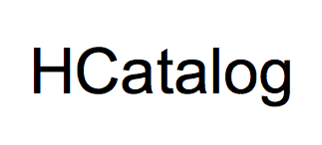

Visualization and Analysis Tools
CSV Files
Query Results

Slide 8
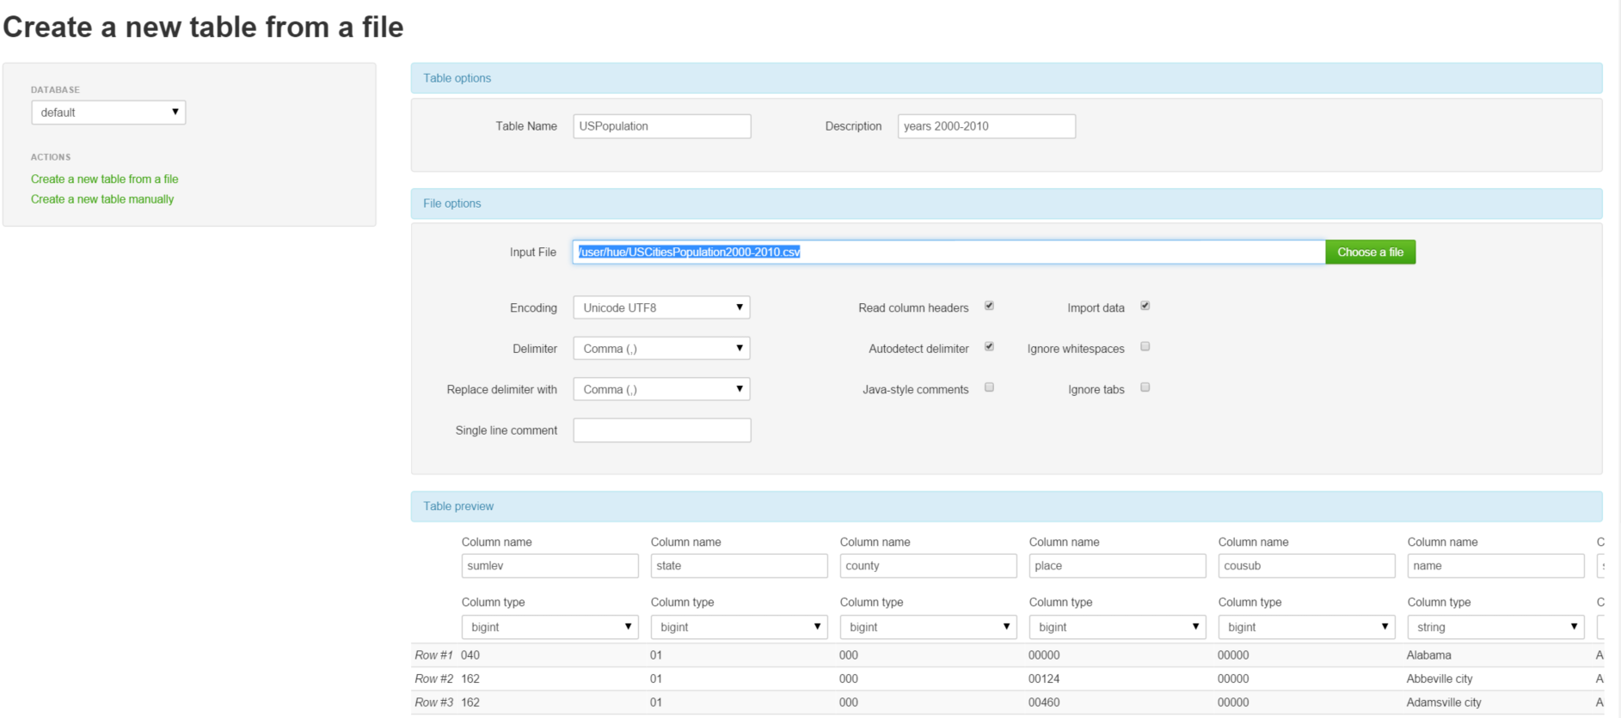
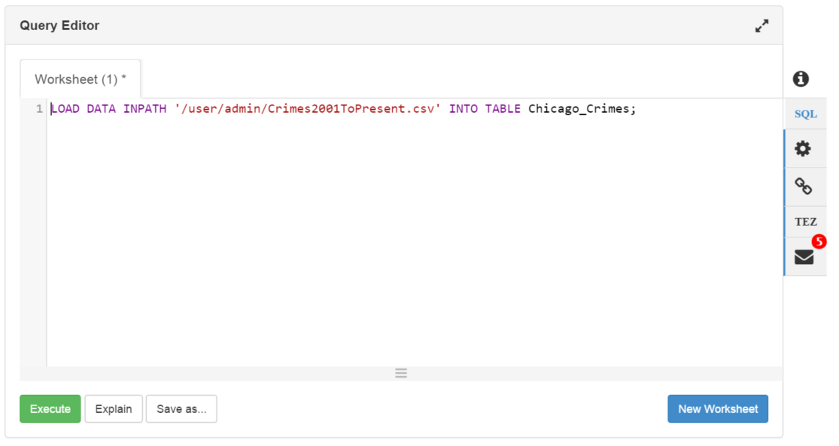
Load Data using hCatalog/hive

Slide 9
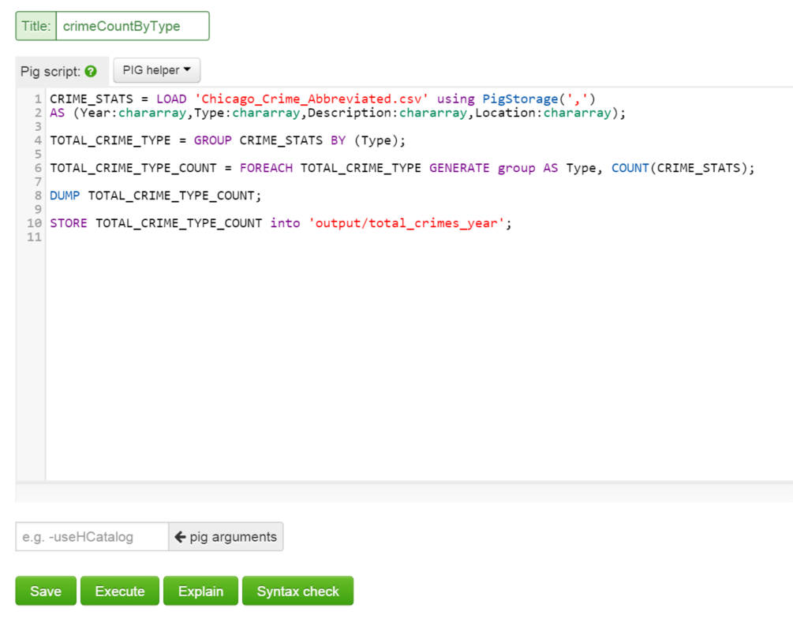
Aggregate data using Pig

Slide 10
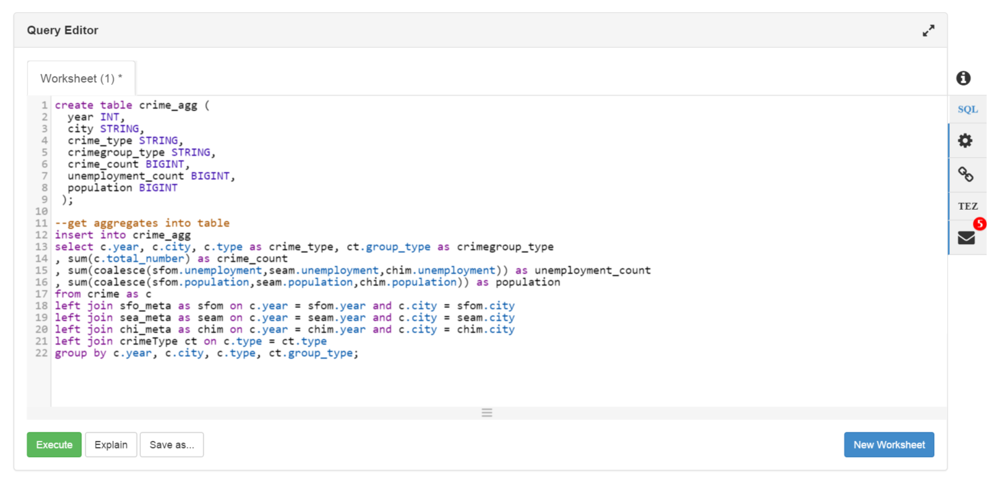
Aggregate data using hive

Slide 11
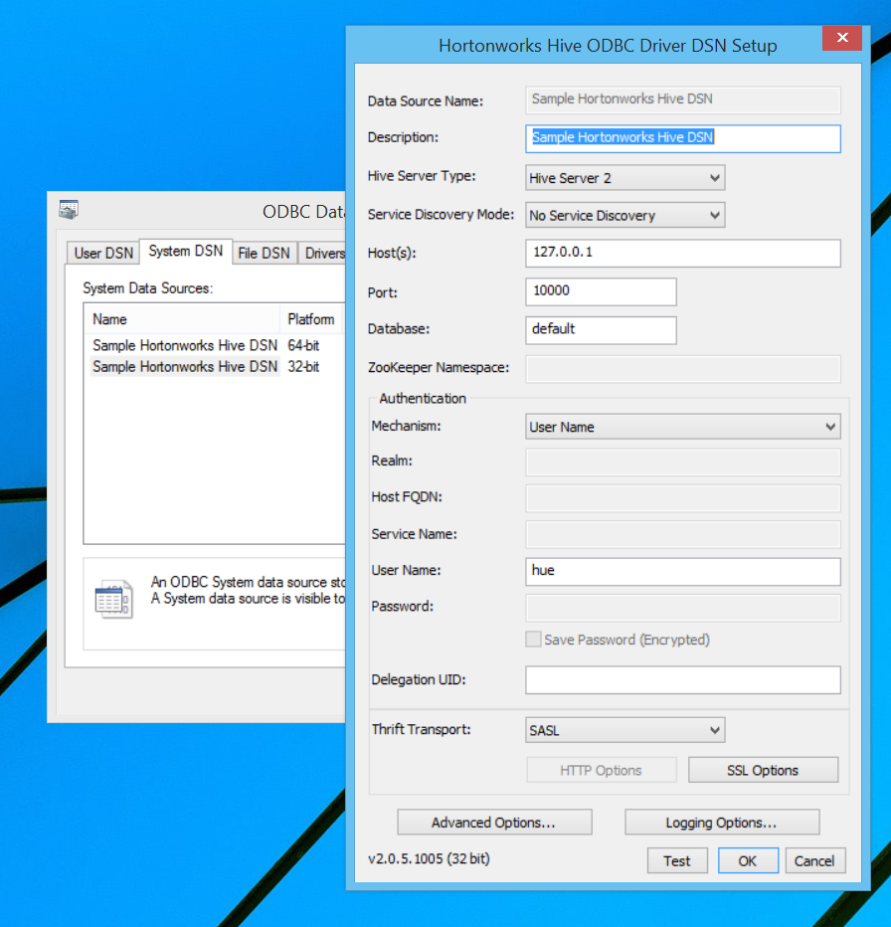
Create HortonWorks DSN

Slide 12
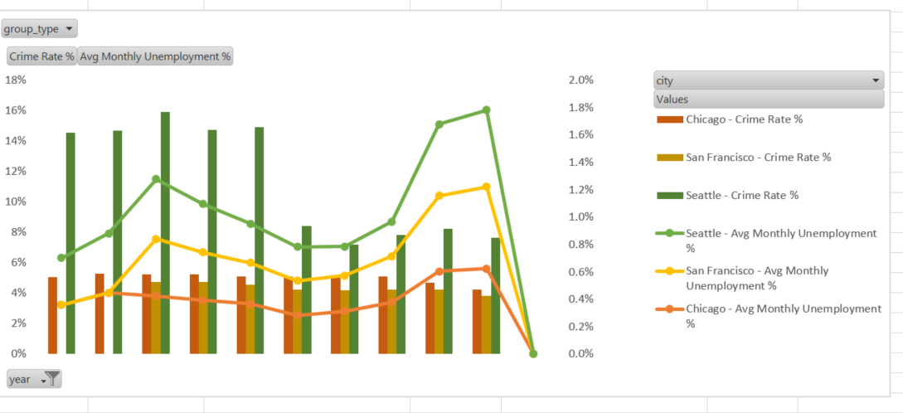
Excel PivotChart

Slide 13
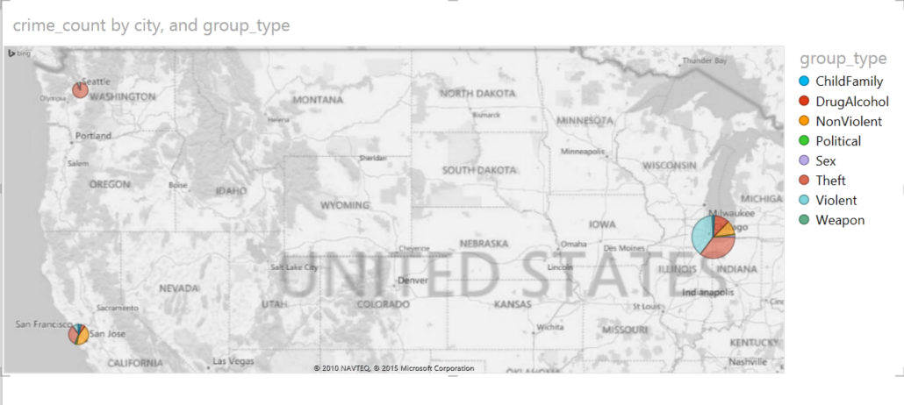
Excel PowerView / PowerMap

